Slide 1
Patient report summarizer
INFORMATION RETRIEVAL ASSIGNMENT 2
Divya, 1ms18cs043, CSE 6A
Gaurav v, 1ms18cs046, CSE 6A

Slide 2
Introduction
Doctors generally spend a lot of time looking at old records to understand a patients health history which results in them not being able to pay more attention to treatment. they can use our model to search through a particular record fast and look at the summarised health history of a patient. They don't have to spend time going through each record. They can search and sort by various features like time period, symptoms, treatment etc and also get a summary of all records according to their choice.
Project Link : https://github.com/Gaurav-71/Patient-Report-Summarizer

Slide 3

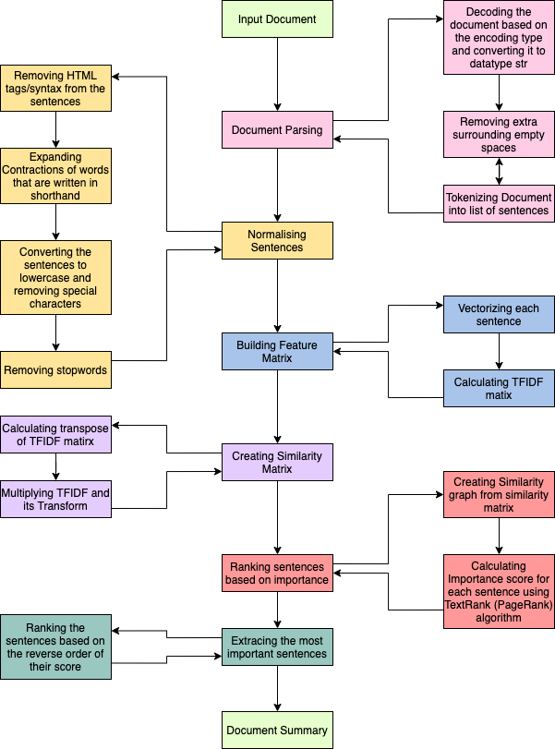
System design

Slide 4
Summariser
This is a feature which lets the Doctor view at the summary of a report for a patient from the database instead of reading through the look report. The technique we are using for summarisation is an Extractive way of summarisation done using TextRank Algorithm. The steps used to implement the algorithm can be briefly described as - 1. Reading the text from the document and Parsing it to get rid of any unwanted characters. 2. Normalising the corpus to get Normalised sentences 3. Building a Feature Matrix of the normalised sentences - we are using the method based on “maximum common words” using TF IDF Vectorising 4. Creating a Similarity Matrix and then a Similarity graph from the Feature Matrix 5. Ranking the Sentences using PageRank Algorithm from the Similarity Matrix. 6. Taking out the most important (highly ranked) sentences from the document and creating the summary.

Slide 5
Universal Search
Easily search for a Name / Symptom / Disease / Sentence or a certain Query. This is a feature that names the doctor to search through the document based on a string which can be anything like a name, a symptom, disease, sentence or any other query. We are using Vector Space Model of ranking documents to implement the same.
View reports by date
We have a Date of Creation associated to each document saved in the database. The user/doctor can search for a Document/Report created between two dates or after a particular date or before a particular date as per his convenience.

Slide 6
Comprehensive Report View
If the doctor decides that he needs to go through the complete report of a patient, that is facilitated as well through our application.
All in one solution
This is the most important and practical feature of the application where the user can search for a medical report created between (after/before) two (one) dates based on a query and view the complete report or the summary of it.

Slide 7
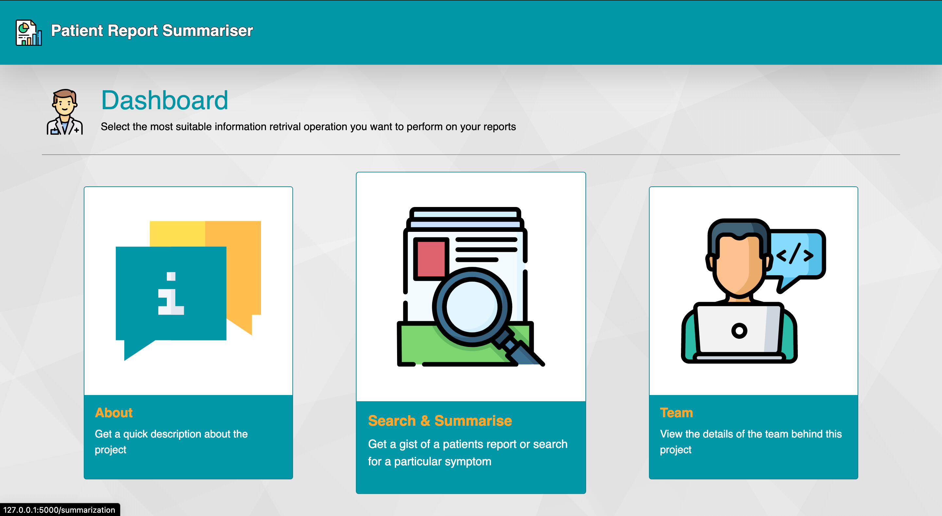
Screenshots

Slide 8
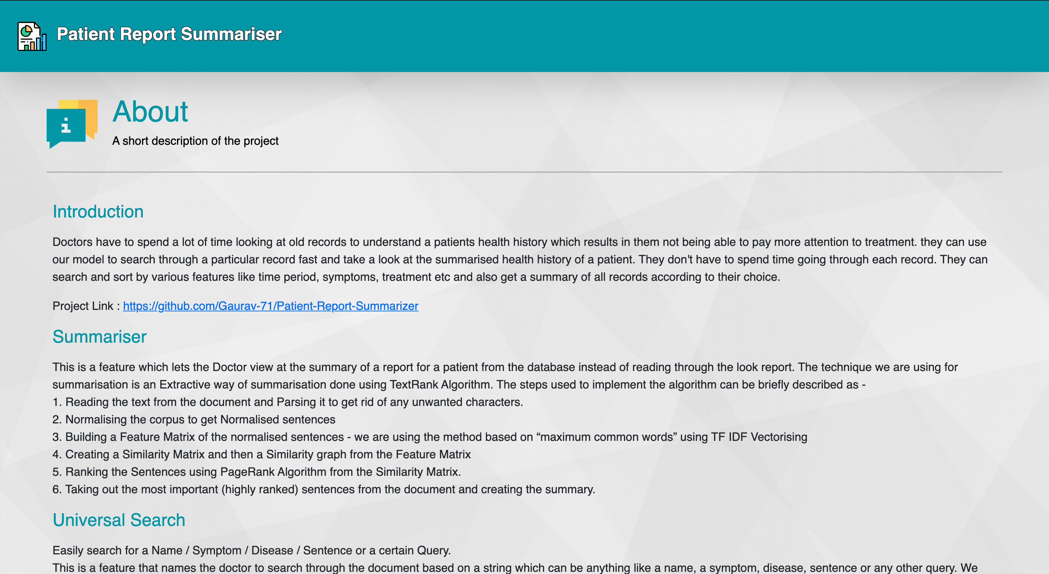
Screenshots

Slide 9
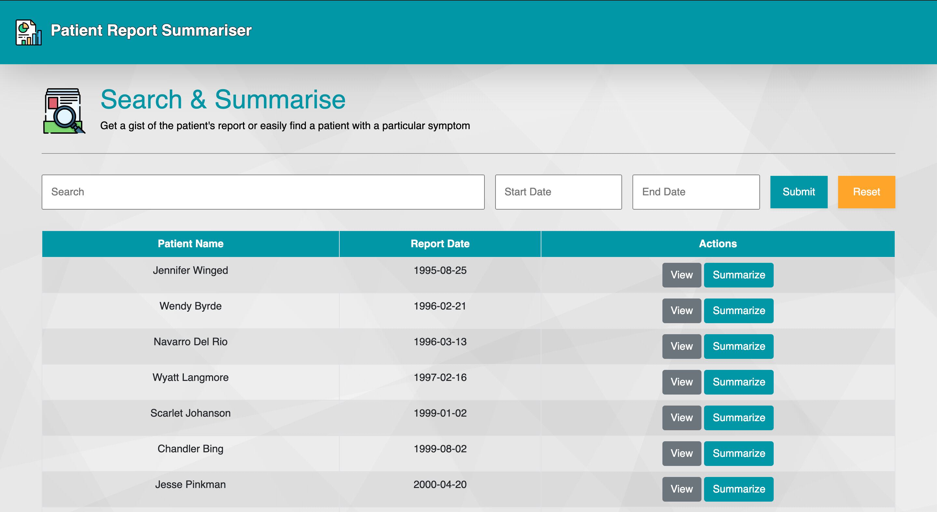
Screenshots

Slide 10
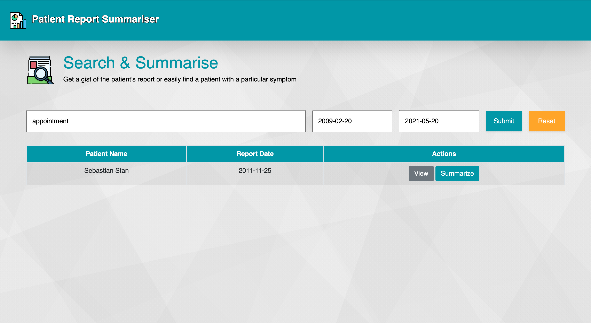
Screenshots

Slide 11
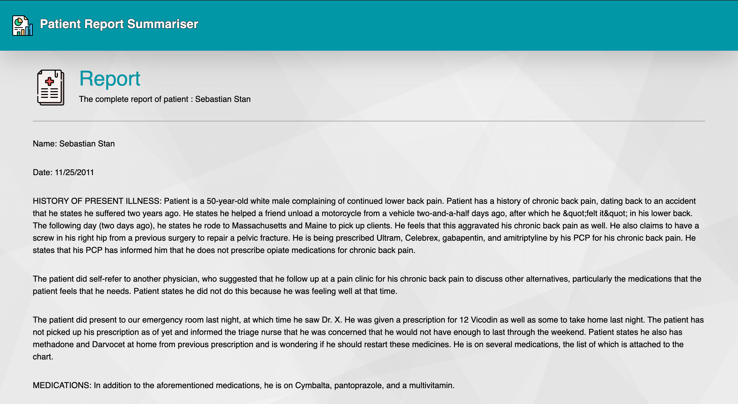
Screenshots

Slide 12
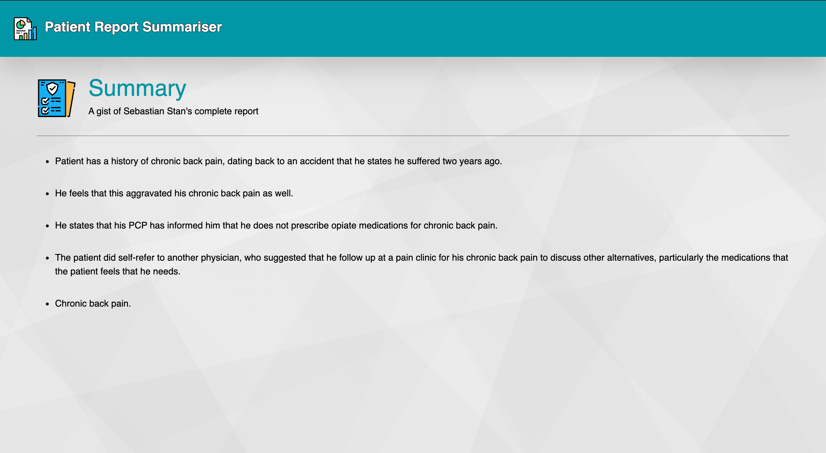
Screenshots

Slide 13
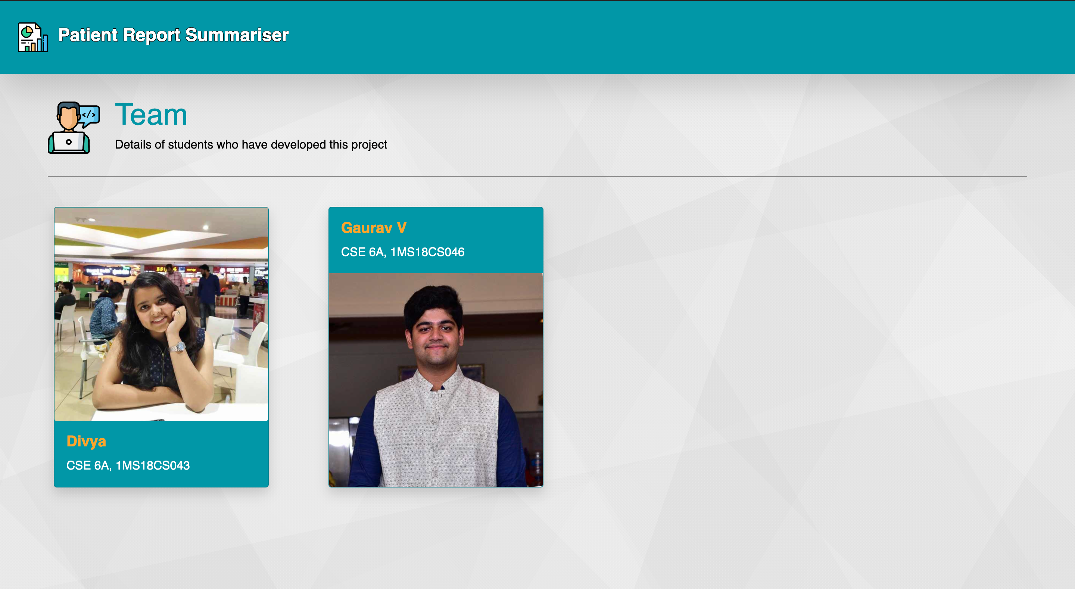
Screenshots

Slide 14
Thank you

